Slide 1
Jermyn Borough Council Meeting
02/15/2024

Slide 2
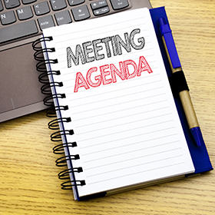
Meeting Agenda
February 15,2024
CALL TO ORDER
PLEDGE OF ALLEGIANCE
ROLL CALL
PREVIOUS MEETING MINUTES
TREASURER REPORT/BILLS PAYABLE
SECRETARY REPORT
CORRESPONDENCE
PUBLIC COMMMENT
PROFESSIONAL REPORTS-POLICE, FIRE, SOLICITOR, ZONING, ENGINEER, TAX COLLECTOR, MAYOR
COMMITTEE REPORTS-SAFETY, PLANNING, FINANCE, SHADE TREE, REC, MS4, DPW
COMMITTEE APPOINTMENTS
ORDINANCE #01-2024- PAVE CUT
RESOLUTION FOR RETENTION PONDS
RUSHBROOK CREEK UPDATE
EXECUTIVE SESSION
NEW BUSINESS

Slide 3
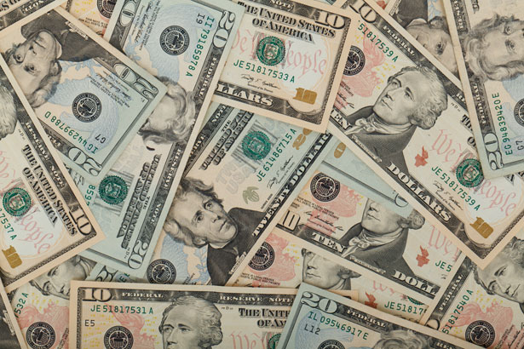
Treasurer’s report
2/15/2024
ASSETS
Checking/Savings
American Rescue Plan Fund 135,744.11
Capital Reserve - DPW 729.52
Capital Reserve - Police 5,399.82
Crime Watch Fund 222.69
General Fund - Community 65,208.45
General Fund - FNB 4,841.31
Holiday Lights Fund 1,459.09

Slide 4
Treasurer’s report
Investment - General Fund 1,069.02
Investment - Liquid Fuels 23,537.82
Investment - Paving Fund 1,080.15
Investment - Recycling 118.06
Investment - Refuse 168.35
Liquid Fuels - FNB 1,237.68
Petty Cash 221.50
Recreations Fund 29,644.31
Recycling - Community 3,468.14
Refuse Checking - FNB 22,143.56
Total Checking/Savings 296,293.58

Slide 5
Treasurer’s report
200000 · Accounts Payable 9,390.68
Long Term Debt 160,122.30

Slide 6
MS4 Minute
https://www.youtube.com/watch?v=sBhzpZD8i8s

